Slide 1
Detecting Credit Card Fraud
Wajahat Sheikh | DSC680 Bellevue University

Slide 2
Why is this important?
Credit Card fraud is on the rise, right here in the US and abroad. With an increasingly technological world, millions of transactions occur daily. Fraud risk increases and security becomes more important than ever

Slide 3
$24,260,000,000
has been lost to credit card fraud worldwide in 2018
18%
Percent by which credit card fraud increased in 2018 and its still climbing!

Slide 4
What is Credit Card Fraud?
Credit card fraud occurs when a person uses another person’s credit card or account to make a transaction.
Stolen Card
Account takeover
Counterfeit cards
New credit
Number theft

Slide 5
About the data
284,807 Rows of Data
31 Features
The features I will focus on
Time | Amount | Class

Slide 6
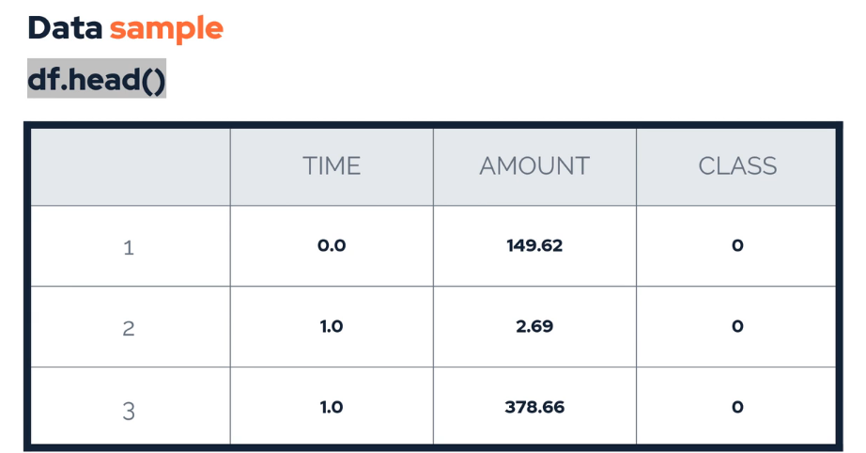
Exploring the data

Slide 7
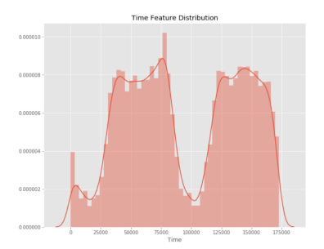
Feature Details
Time Feature
175,000 seconds
48 Hours
2 days

Slide 8
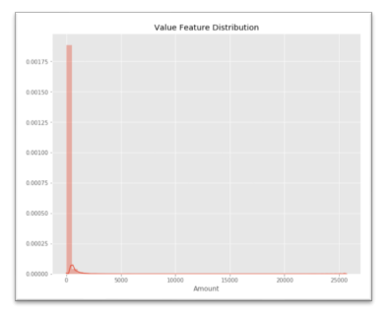
Feature Details
Amount Feature
25,961.16 max
88.35 average
Right Skew

Slide 9
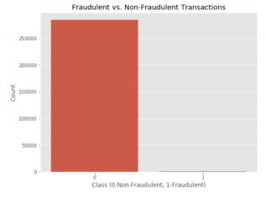
Feature Details
Class Feature
99.83%
0.17 Fraud

Slide 10
Most machine learning algorithms work best when the number of samples in each class are about equal. This is because most algorithms are designed to maximize accuracy and reduce error.

Slide 11
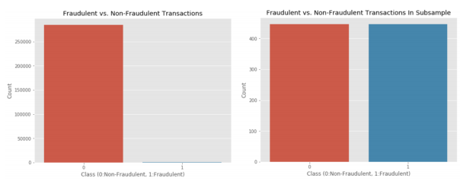
Balanced Data

Slide 12
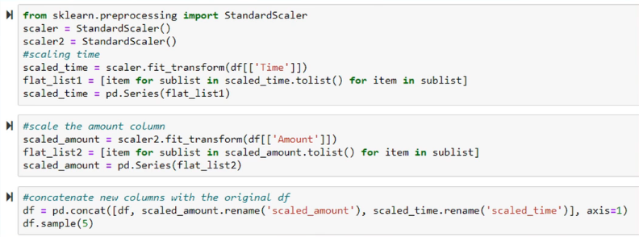
Scaling the data

Slide 13
Working with outliers
Retaining can distort statistical analyses and violate their assumptions.
Excluding can cause your results to become statistically significant.

Slide 14
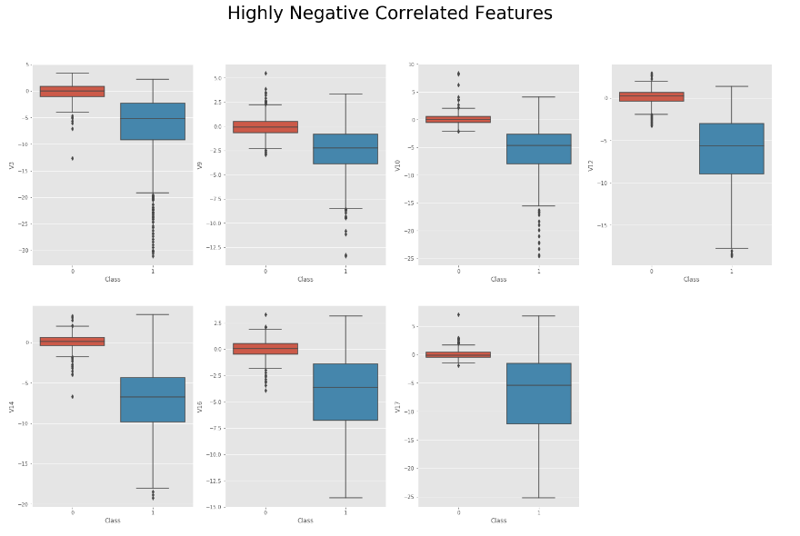
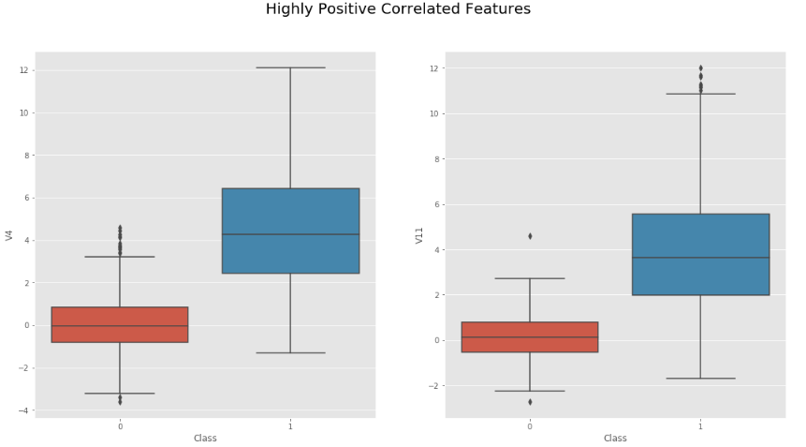
Working with outliers

Slide 15
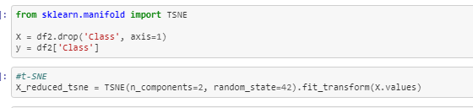
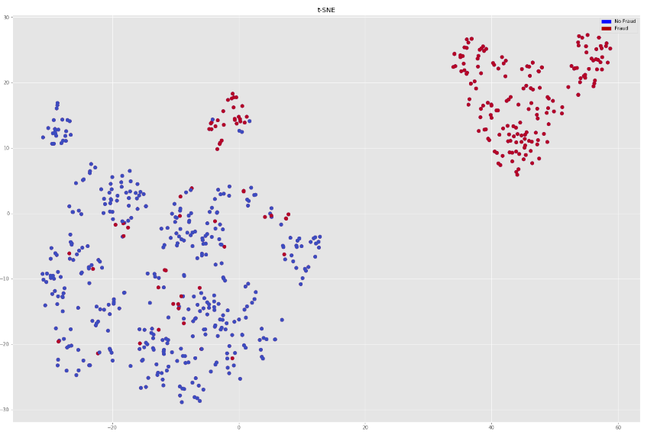
Dimensionality Reduction

Slide 16
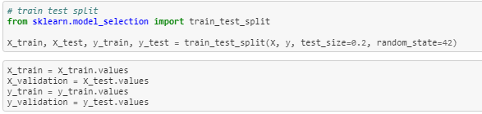
Train Test split

Slide 17
Process was easy!
Logistic Regression
LDA
KNN
Classification Trees
Support Vector
Random Forest

Slide 18
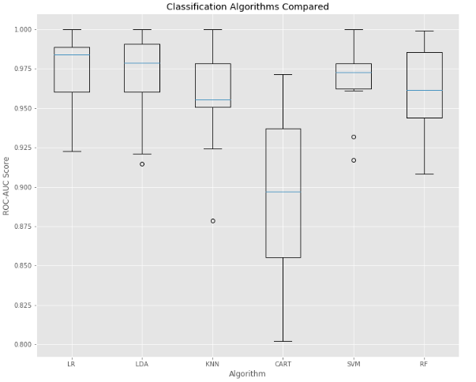
Classification Algorithms compared

Slide 19
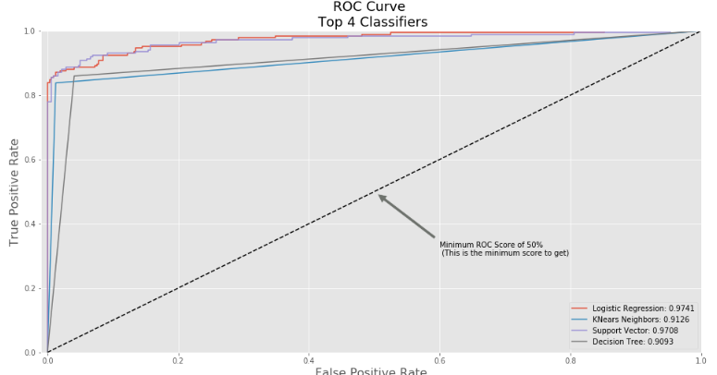
Classification Algorithms compared

Slide 20
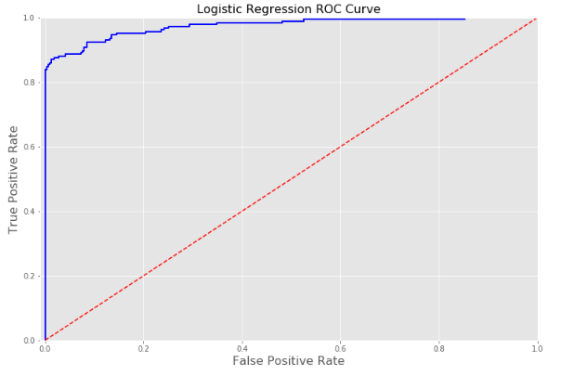
Classification Algorithms compared

Slide 21
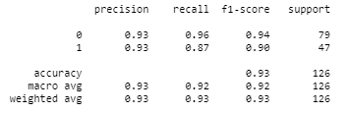
Classification Algorithms compared

